Slide 1

SAP Analytics cloud training
Anubhav Oberoy
Day 10

Slide 2
Agenda – Day 10
Value Driver Tree
- Continue VDT Scenario
- Create New Model
---Break---
Data Actions and Collaboration
- Introduction to Data Actions
- Types of data actions
- Copy Data action
- Scripted Data action scenario
- Collaboration
Notes:
Data Actions & Connections Basics
Data Actions in SAC
Introduction to Connections
Cloud Connector
Connecting to Import data with BW
Connecting to S/4HANA System
---Break---
Build CDS Views
Introduction to CDS View
Consume S/4HANA CDS views
Import data connection
Live Data connection with analytic Query

Slide 3

Use case 2
We would like observe the impact of market growth, price index, growth rate on our net revenue. VDT is just a representation of account dimensions connected together. All the calculations related to VDT are going to be done inside the MODEL.
Gross Sales = Quantity (~MarketGrowth, ~SalesAmbition) X Price (~PriceIndex)
Net Sales = gross Sales – Discount (~Discount %)
Price
Price Index
Gross Sales
Market Growth Index (Base)
Quantity
Net Sales
Sales Ambition %
Discount
Discount %
www.anubhavtrainings.com

Slide 4
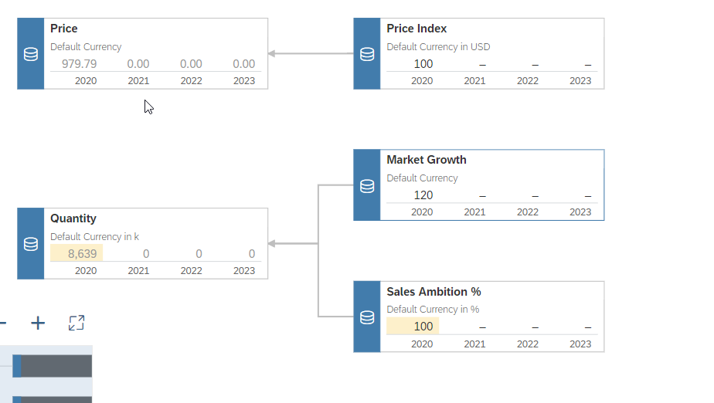
Avg. Price
Price Index
Market Growth Index
Quantity (Sim)
Sales Ambition %

Slide 5
New Model
Classic Model New Model
We have only one measure which is an account measure, that contains all the values combining together.
We cannot add calculated measure while building this model.
The account dimension concept resembles from old BI tools.
Data mapping is old style and tell about the errors only at the final creation steps.
A default measure with name called value gets created.
We can have individual measures along with account dimension also. While building the model, based on preference, we can choose structural priority.
We can add a calculated measure while building the model.
We can develop model which look exactly same as database table in your source system.
We use a enhanced mapping tool which will show a guided flow and unearthed the errors in early phase.
The name of the measure will be same name as column name from the source.
The main purpose is to avoid confusion related to the account dimension in data model for layman.
www.anubhavtrainings.com

Slide 6
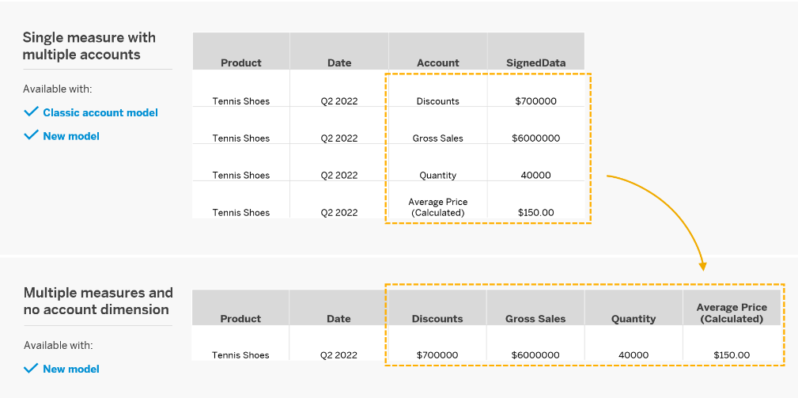
New Model

Slide 7

Data Actions
Used for automating work in SAC planning. They helps end users/planning experts to perform complex tasks with the click of a button.
e.g. if we would like to distribute, allocate, copy, calculate data in planning model, the user needs to do that manually by changing values in report, or needs to have deep understanding of SAC.
You as SAC planning consultant can automate this work with data actions. End user, will just click on a button and the work will be done.
https://help.sap.com/viewer/00f68c2e08b1041f081002fd36101d86a7/release/en-US/afe103e3cf1414a7b84110baad11cc066e.html#loioafe103e3cf1414a7b84110baad11cc066e__data_resultlookup
www.anubhavtrainings.com

Slide 8
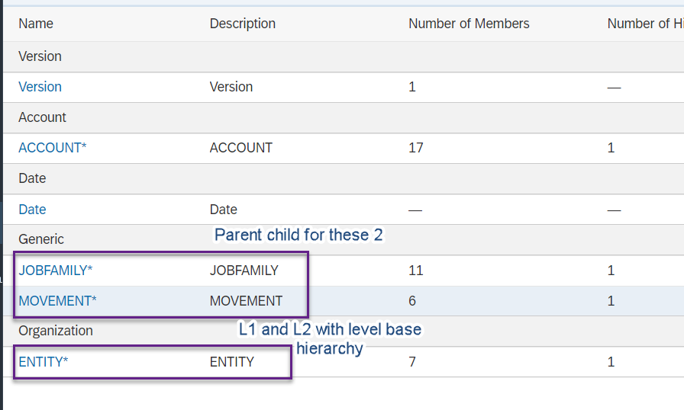

Slide 9
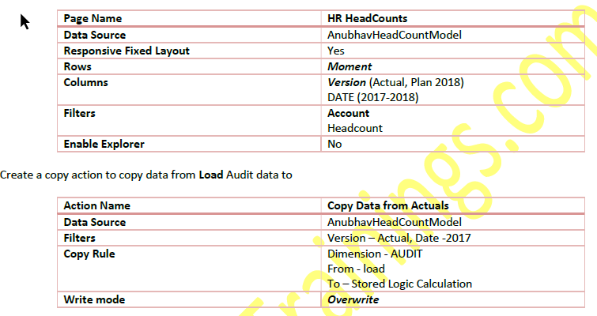
Requirement 1: Copy Data Action
Create Story action to copy the data of 2017 headcount to 2018 plan version
www.anubhavtrainings.com

Slide 10
Requirement 2: Auto calculate headcounts based on Scripting based actions
Finally, we would like to calculate the headcounts based on Hires and Terminations. For calculation, we have to set the opening balance to the ending balance of previous period and Add new hires and subtract the terminations to calculate the final balance. These set of actions needs to be repeated for entire duration on MoM basis.
This is performed using the scripting-based actions, for the ease of writing Anubhav will also show Visual way of writing the script.
CONFIG.TIME_HIERARCHY = CALENDARYEAR
CONFIG.FLIPPING_SIGN_ACCORDING_ACCTYPE = OFF
CONFIG.GENERATE_UNBOOKED_DATA = OFF
MEMBERSET [d/Date] = (BASEMEMBER([d/Date].[h/YQM], "2018"))
FOREACH [d/Date]
DATA([d/MOMENT] = "OPENING") = RESULTLOOKUP([d/MOMENT] = "CLOSING", [d/Date] =
Previous(1))
DATA([d/MOMENT] = "CLOSING") = RESULTLOOKUP([d/MOMENT] = "OPENING") +
RESULTLOOKUP([d/MOMENT] = "HIRES") - RESULTLOOKUP([d/MOMENT] = "TERMINATIONS")
ENDFOR
www.anubhavtrainings.com

Slide 11
End of Day 10

Slide 12

Questions

Slide 13

Anubhav Oberoy
anubhav.abap@gmail.com

